Slide 1
Sampling and Estimation

Slide 2
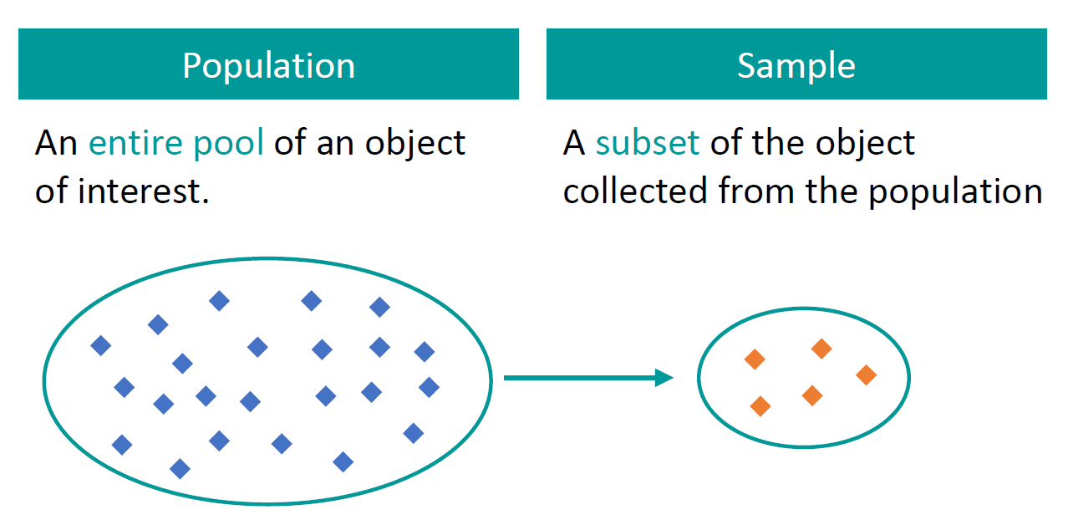
Sampling and Population
Population (N) = Entire group of subjects we are interested in
Sample (n) = A smaller group within the larger population

Slide 3
Sampling Techniques
Probability sampling: Random selection
Every member of the population has a chance of being selected
Most appropriate
Mainly used in quantitative research
Non-probability sampling: Non-random selection
Not every individual has a chance of being included
Easier and cheaper to access, has a higher risk of sampling bias
Used in qualitative research

Slide 4
Probability Sampling
Type | Brief description | Method | Example
Simple | Every member of the population has an equal chance | Random number generator | Assign # 1 to 1000 to employees and select n random samples
Systematic | Similar but easier | Choose at regular intervals | Pick employee # 7, 17, 27, 37, 47, …
Stratified | More representative, if we have sub-categories within data | Divide population into strata (sub-groups) and then pick proportionate samples from each | If we have 700 women employees and 300 men employees, pick 70 women and 30 men in the sample
Cluster | Similar, but use entire sub-groups, rather than samples within sub-groups | Divide population into clusters and pick entire clusters as samples | If the offices are in Pune, Mumbai, Delhi, Bangalore, Hyderabad, and Chennai select Pune and Chennai as samples

Slide 5
Non-Probability Sampling
Type | Brief description | Method | Example
Convenience | Just pick sample data as per one’s convenience | No systematic method | To research opinions about student support services in our university, we ask our fellow students to complete a survey on the topic
Voluntary-response | People voluntarily come forward | Start with the people who are interested – May be biased | Ask employees about problems faced through a third-party survey – unhappy employees will come forward on their own
Purposive | Done for a specific purpose, also called judgment sampling | Reach the right people and then do a detailed study | We want to know the opinions of foreign students at C-DAC, so we specifically talk to them about a variety of topics
Snowball | Recruit more participants via existing participants | Create a snowball of participants | Homeless people survey – Initially difficult to find such people to speak – But they may help us speak with others soon

Slide 6
Unbalanced Data
Unbalanced data: When there is a large discrepancy between positive and negative cases
Example: Fraud is rare and most rows in the dataset will be ‘No fraud’
Solutions:
Oversampling: Randomly duplicate samples from the minority class to increase the size of the minority class
Undersampling: Randomly remove samples from the majority class – Usually not recommended
SMOTE (Synthetic Minority Oversampling Technique): Artificially generate new samples of the minority class using nearest neighbors
Run K-nearest-neighbors of each sample in the minority class
Create a sample from the KNN result (mean of the neighbors)

Slide 7
Hands-On
C:\code\Data Analytics\smote.py

Slide 8
The Central Limit Theorem (CLT)

Slide 9
Central Limit Theorem (CLT)
Population->Samples
1 lakh examination result of students->100 samples of 1000 students each
For each sample, calculate average marks (Sample mean or x̄)
Plot these sample means on a graph
They will follow normal distribution
This is called as the Central Limit Theorem (CLT)
Generally, minimum sample size = 30
How many such samples? No such number

Slide 10
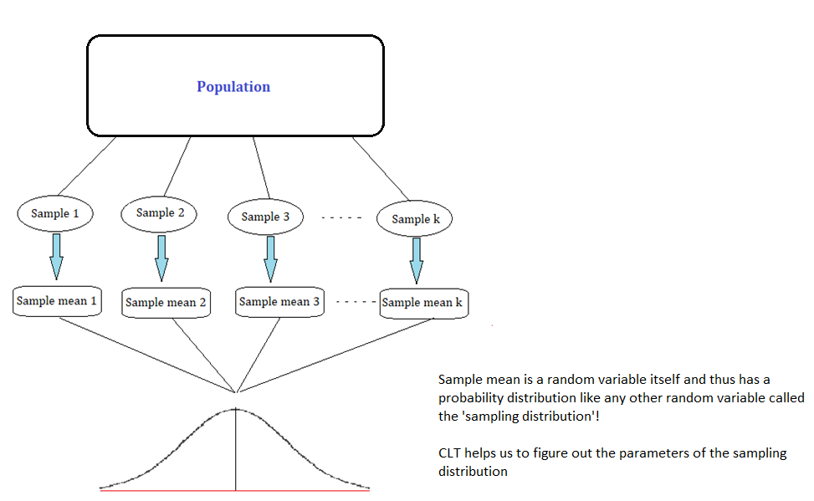
Central Limit Theorem (CLT)

Slide 11
Use of CLT
We can make probabilistic statements about the sample statistic (x̄) even without knowing the population parameters (μ)
We do not bother if the population really follows normal distribution, and yet we can use tests such as t-test, z-test, which are applicable on normal distribution
Hypothesis testing is possible – Use samples to make assumptions about the population

Slide 12
CLT Example
C:\code\Data Analytics\CLT.py
C:\code\Data Analytics\CLT-titanic.py

Slide 13
Hypothesis Testing

Slide 14
Hypothesis
Hypothesis testing: Lets us evaluate how well a sample supports an assumption about the population using these steps:
State our assumption (Null hypothesis and Alternate hypothesis)
Determine probability of error (level of significance)
Check how well the data supports our assumption (Calculate test statistic)
Translate that into a probability that supports it (p-value)
Conclusion: Is it worse than the accepted probability of error?
Yes – Our assumption was wrong – Reject Null hypothesis
No – Our assumption was correct – Fail to reject Null hypothesis
Alternatively, compare test statistic with critical value and decide
Sample statistic: x bar (Sample mean) -> Population parameter: meu (Population mean)

Slide 15
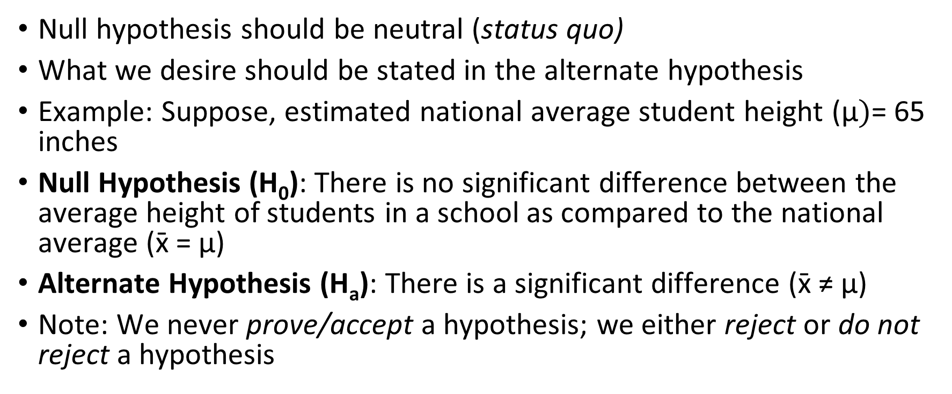
Null and Alternate Hypotheses
Null hypothesis should be neutral (status quo)
What we desire should be stated in the alternate hypothesis
Example: Suppose, estimated national average student height ($\text{μ})$= 65 inches
Null Hypothesis (H₀): There is no significant difference between the average height of students in a school as compared to the national average ($\text{x}\text{̄}$= $\text{μ}$)
Alternate Hypothesis (H_{a}): There is a significant difference ($\text{x}\text{̄}$≠ $\text{μ}$)
Note: We never prove/accept a hypothesis; we either reject or do not reject a hypothesis

Slide 16
Framing the Hypothesis
If we are testing a claim that we want to be true, but cannot assume it, we test its opposite
Example: Our claim: By studying from this book, our marks will improve – But this will not be our null hypothesis, it will be the alternate hypothesis
Null hypothesis: We will get the same marks as before after reading this book
Alternate hypothesis: Our marks will improve after reading the book

Slide 17
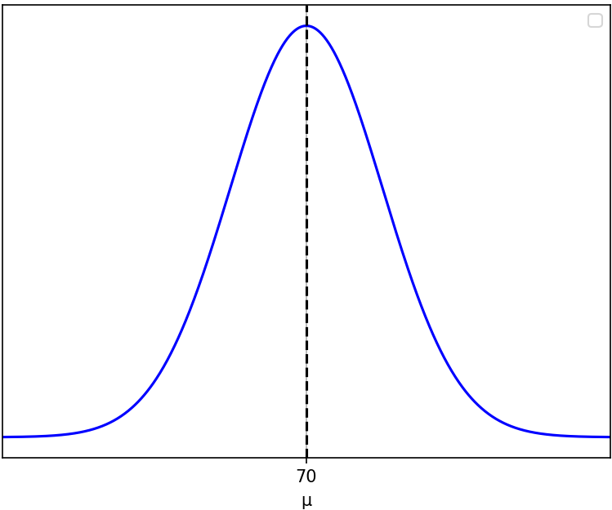
Significance Level
Significance level (Alpha): The probability of rejecting the null hypothesis even though it is true (Type I Error)
Most commonly set to 1%, 5%, or 10%
Example: A course head thinks average student score is 70%
H0: Population mean score (μ) = 70%, H1: Population mean score (μ) ≠ 70%
So, scores distribution should look like this

Slide 18
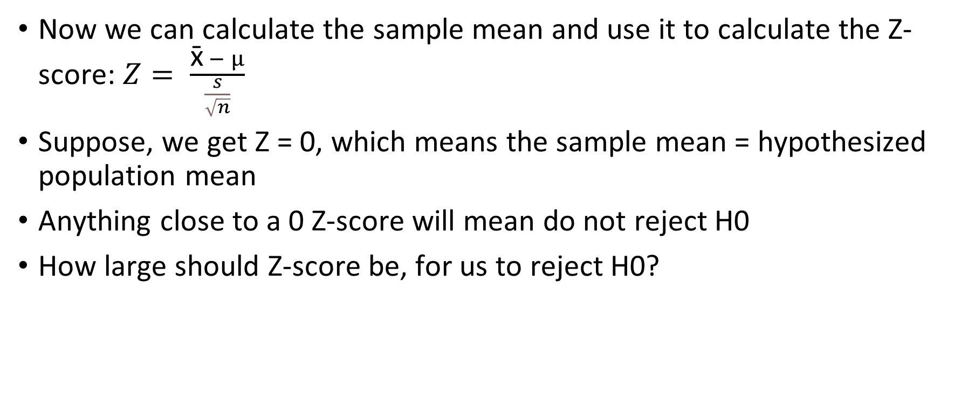
Significance Level
Now we can calculate the sample mean and use it to calculate the Z-score: $Z= \frac{\text{x}\text{̄} − μ}{\frac{s}{\sqrt{n}}}$
Suppose, we get Z = 0, which means the sample mean = hypothesized population mean
Anything close to a 0 Z-score will mean do not reject H0
How large should Z-score be, for us to reject H0?

Slide 19
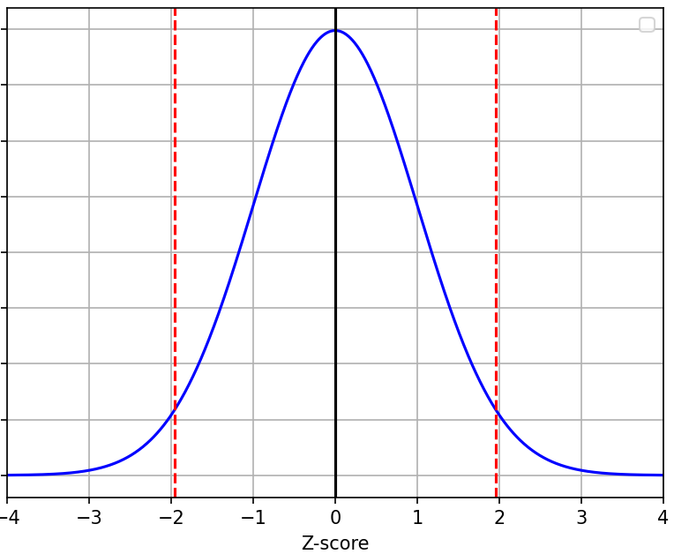
Significance Level
If Z-score is in the middle part, we do not reject H0
But if it goes beyond the dashed red lines, we reject H0 – Why?
Those are rejection regions
Area of rejection regions depends on
significance level (alpha)
If alpha = 0.05, we have 0.025 on both sides
From Z-table, when alpha = 0.025,
Z-score = 1.96 on RHS and -1.96 on LHS
So, if Z-score < -1.96 or > 1.96, reject H0

Slide 20
Type I, II Errors, Alpha Beta
 | H0 is True | H0 is False
Reject H0 | Type I Error, Alpha | Correct
Do not Reject H0 | Correct | Type II Error, Beta
Why can this happen? Bad sample data …
Example: We got a bad sample where Average sample score = 80
We would reject H0 because in our sample it seemed so, although in general it is true, considering all the other samples

Slide 21
One-Tailed and Two-Tailed Tests
One-tailed and two-tailed tests: Direction of hypothesis testing
One-tailed: We look for < or > values, so critical values are in one region only
Two-tailed: No direction, we look for absolute difference, so critical region is split between two tails of the distribution
Example: A new medicine is being tested with current lifespan = 70 years
One-tailed Test
H0: Lifespan = 70
H1: Lifespan > 70
Two-tailed Test
H0: Lifespan = 70
H1: Lifespan ≠ 70
C:\code\Data Analytics\One_tailed_Two_tailed.py
Reject H0 if lifespan <= 70
Need to observe a larger effect to reject H0
Reject H0 if lifespan ≠ 70
Comparatively easier to reject H0

Slide 22
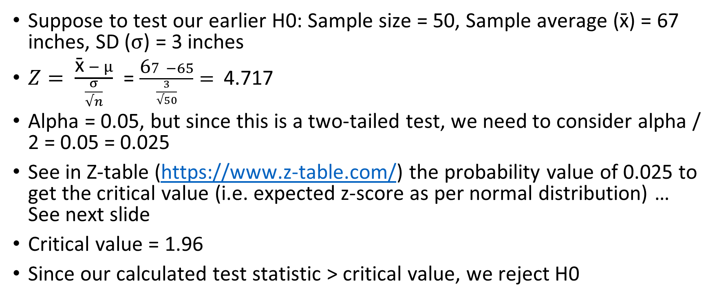
Calculate Test Statistic
Suppose to test our earlier H0: Sample size = 50, Sample average ($\text{x}\text{̄}$) = 67 inches, SD ($σ$) = 3 inches
$Z= \frac{\text{x}\text{̄} − μ}{\frac{σ}{√n}}$ = $\frac{\text{6}7 −65}{\frac{3}{√50}}=$ 4.717
Alpha = 0.05, but since this is a two-tailed test, we need to consider alpha / 2 = 0.05 = 0.025
See in Z-table (https://www.z-table.com/) the probability value of 0.025 to get the critical value (i.e. expected z-score as per normal distribution) … See next slide
Critical value = 1.96
Since our calculated test statistic > critical value, we reject H0

Slide 23
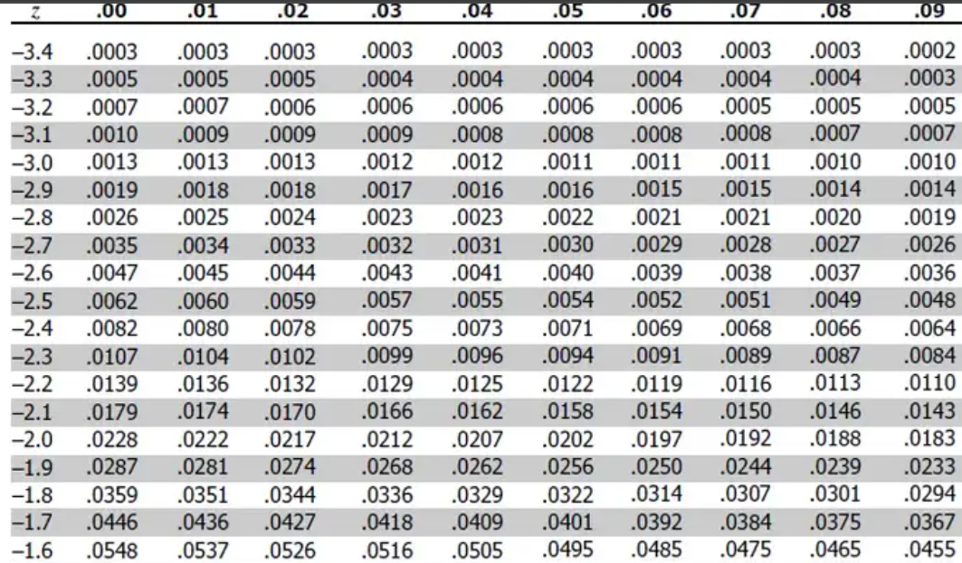
How to Get Critical Value from Z-Table
Look for our probability value
That is 0.025
Critical value = Row + Column
Critical value = 1.9 + .06
Critical value = 1.96
Note: If we look in the positive Z-table (the second table on the same page, we will need to look for 1 – 0.025, i.e. 0.975 and we will get the same result, i.e. 1.96)

Slide 24
p-value
p-value = Area of rejection
Low p-value: Reject H0, High p-value: Fail to reject H0
For our example, p-value < 0.00001 (See https://www.socscistatistics.com/pvalues/normaldistribution.aspx)
Interpretation: If our null hypothesis were true we would expect to see a Z-value of 4.717 in < 0.00001% of cases just due to random sampling variability
Since p-value < 0.05, the observed we reject H0

Slide 25
Conclusion
Fail to reject H0

Slide 26
Null Hypothesis – How to State?
Test | Null Hypothesis
One-sample T-Test | There is no significant difference between the sample mean and the hypothesized population mean
Two-sample T-Test | The population means of the two groups are equal
Chi-Square Test | There is no association between the two categorical variables (they are independent)
ANOVA | The means of multiple groups are equal
Linear regression | The coefficients of the independent variables are equal to zero (no relationship)
Logistic regression | There is no association between the independent variables and the binary outcome

Slide 27
Type I and Type II Errors – Example
H₀: John’s used car is not safe to drive
Possibilities
John thinks that his car may be safe when in fact it is not safe - Error
John thinks that his car may be safe when in fact it is safe - Ok
John thinks that his car may not be safe when in fact it is not safe - Ok
John thinks that his car may be not be safe when in fact it is safe – Error
Which of these is Type I and which is Type II Error?

Slide 28
Type I and Type II Errors – Example
H₀: John’s used car is not safe to drive
Possibilities
John thinks that his car may be safe when in fact it is not safe - Error
John thinks that his car may be safe when in fact it is safe - Ok
John thinks that his car may not be safe when in fact it is not safe - Ok
John thinks that his car may be not be safe when in fact it is safe – Error
Which of these is Type I and which is Type II Error?
Remember:
Type I Error occurs when H₀ is true
Type II Error occurs when H₀ is false
In this example: H₀: John’s used car is not safe to drive
So:
(d) is Type II error
(a) is Type I error
Which error is more serious?
Type I

Slide 29
Type I and Type II Errors – Another Example
In a criminal court case, H₀: The defendant is not innocent
Possibilities:
The jury believes that the defendant is guilty when she is innocent - Error
The jury believes that the defendant is guilty when she is not innocent - Ok
The jury believes that the defendant is innocent when she is not innocent - Error
The jury believes that the defendant is innocent when she is innocent – Ok
What are Type I and Type II errors here, and which one is more dangerous?

Slide 30
Type I and Type II Errors – Another Example
In a criminal court case, H₀: The defendant is not innocent
Possibilities:
The jury believes that the defendant is not innocent when she is innocent - Error
The jury believes that the defendant is not innocent when she is not innocent - Ok
The jury believes that the defendant is innocent when she is not innocent - Error
The jury believes that the defendant is innocent when she is innocent – Ok
What are Type I and Type II errors here, and which one is more dangerous?
Remember:
Type I Error occurs when H₀ is true
Type II Error occurs when H₀ is false
In this example: H₀: Defendant is innocent
(c) Type I error
(a) Type II error
Which one is more serious?
Perhaps (a), but then someone can also argue it is (c), depending on the situation and the crime

Slide 31
Chi Square Test

Slide 32
Chi-Square Test
Chi-square test: Used to analyze relationships between categorical data
Chi-square test for homogeneity: Are probability distributions for two different groups homogeneous with respect to some characteristic?
Chi-square test for association/independence: Do we find a significant association between two categorical variables?
Chi-square test for goodness of fit: Does data fit a specified distribution?

Slide 33
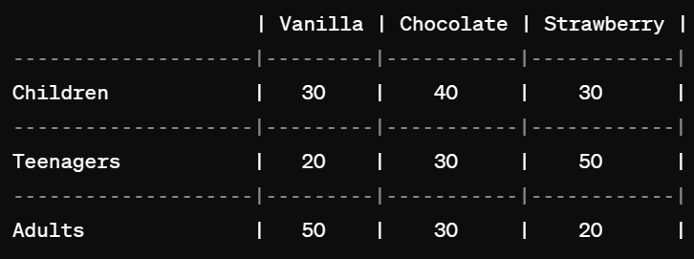
Chi-square Test for Homogeneity
Ice cream preference of 300 people, 100 each from three categories
Null Hypothesis (H0): There is no difference in ice cream flavor preference among the different age groups
Alternative Hypothesis (H1): There is a difference in ice cream flavor preference among the different age groups

Slide 34
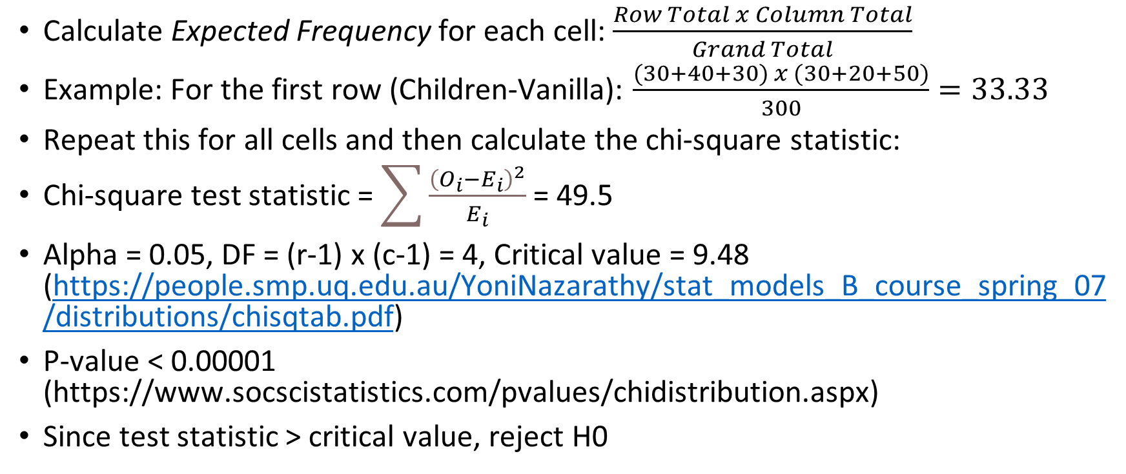
Chi-square Test for Homogeneity
Calculate Expected Frequency for each cell: $\frac{Row Total x Column Total}{Grand Total}$
Example: For the first row (Children-Vanilla): $\frac{(30+40+30) x (30+20+50)}{300}=33.33$
Repeat this for all cells and then calculate the chi-square statistic:
Chi-square test statistic = $\sum{\frac{{\left(O_{i}−E_{i}\right)}^{2}}{E_{i}}}$ = 49.5
Alpha = 0.05, DF = (r-1) x (c-1) = 4, Critical value = 9.48 (https://people.smp.uq.edu.au/YoniNazarathy/stat_models_B_course_spring_07/distributions/chisqtab.pdf)
P-value < 0.00001 (https://www.socscistatistics.com/pvalues/chidistribution.aspx)
Since test statistic > critical value, reject H0

Slide 35
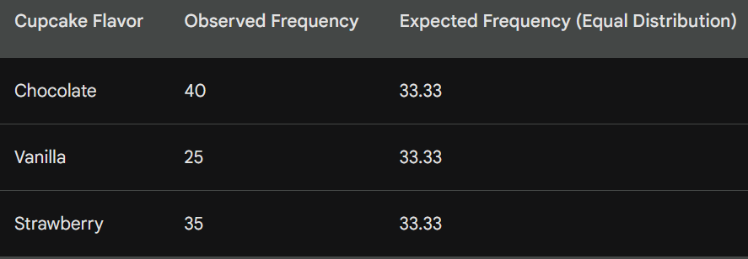
Chi-square Test for Goodness of Fit
Checks if the observed frequencies of a single categorical variable match with a pre-defined expected distribution
Example: A bakery wants to see if their customers prefer chocolate, vanilla, or strawberry cupcakes equally. They record sales for a week.
H0: All flavors have equal preferences

Slide 36
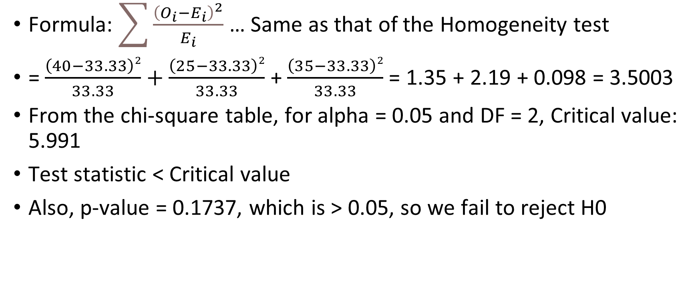
Chi-square Test for Goodness of Fit
Formula: $\sum{\frac{{\left(O_{i}−E_{i}\right)}^{2}}{E_{i}}}$ … Same as that of the Homogeneity test
= $\frac{\left(40−33.33\right)2}{33.33}+\frac{\left(25−33.33\right)2}{33.33}$ + $\frac{\left(35−33.33\right)2}{33.33}$ = 1.35 + 2.19 + 0.098 = 3.5003
From the chi-square table, for alpha = 0.05 and DF = 2, Critical value: 5.991
Test statistic < Critical value
Also, p-value = 0.1737, which is > 0.05, so we fail to reject H0

Slide 37
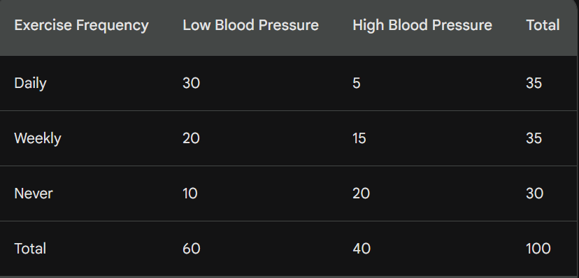
Chi-square Test for Independence
Is there a significant association between two categorical variables?
H0: There is no relationship between exercise frequency and blood pressure levels

Slide 38
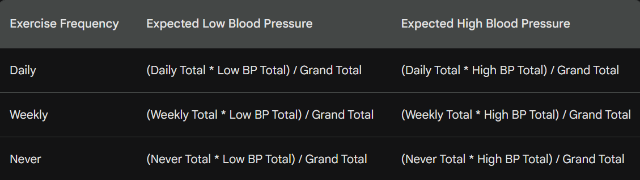

Chi-square Test for Independence
Formula: $\sum{\frac{{\left(O_{ij}−E_{ij}\right)}^{2}}{E_{ij}}}$

Slide 39
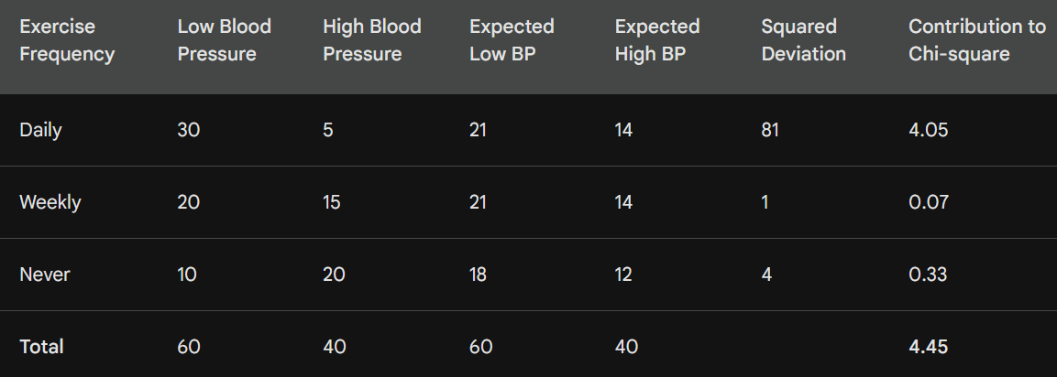
Chi-square test for independence
Calculate expected frequencies

Slide 40
Chi-square Test for Independence
Test statistic: 4.45
Alpha = 0.05, Degrees of freedom: 2, Critical value = 5.99
test statistic < critical value
Also, p-value: 0.108 > alpha
We fail to reject H0

Slide 41
Chi-Square Python Functions: stats.chisquare
stat.schisquare()
Goodness of fit
chi2_contingency()
Homogeneity or Independence … Same function is used
C:\code\Data Analytics\chi_square_independence.py

Slide 42
Decision Trees

Slide 43
Decision Tree Concept
Decision tree: A flowchart for classification and regression (Hence: Classification And Regression Tree – CART)
Type of supervised machine learning
Classification example
Check email is spam/not
Root node of the tree checks if the email contains the word free
If yes, follow branch Spam, else follow a different branch Not spam
Further nodes will check features such as sender’s address etc
Regression example
Predict house price
Root node will check area (<= 1500 square feet or not)
If yes, follow Lower price branch, else follow Higher price branch
Further nodes will check features such as number of bedrooms etc

Slide 44




Entropy
Entropy: Tells us how homogeneous a dataset is
High entropy: Data has high variability
Low entropy: Data has low variability

Slide 45
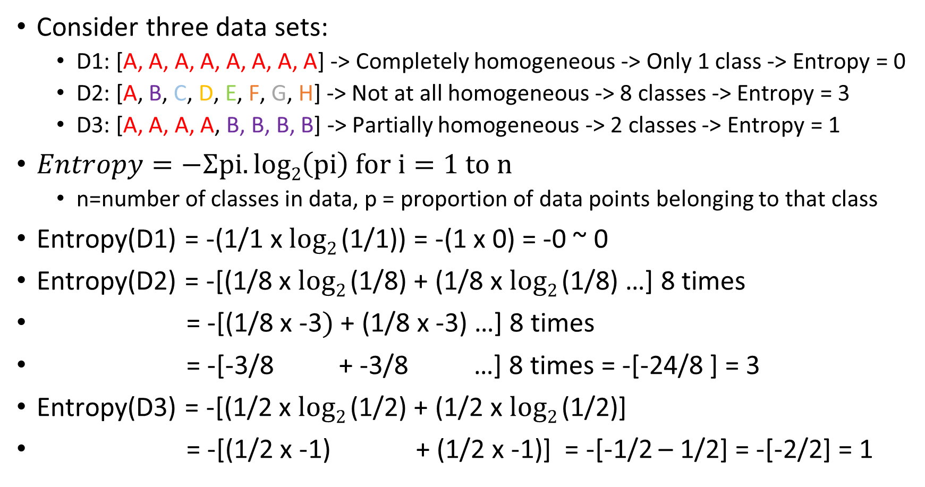
Entropy
Consider three data sets:
D1: [A, A, A, A, A, A, A, A] -> Completely homogeneous -> Only 1 class -> Entropy = 0
D2: [A, B, C, D, E, F, G, H] -> Not at all homogeneous -> 8 classes -> Entropy = 3
D3: [A, A, A, A, B, B, B, B] -> Partially homogeneous -> 2 classes -> Entropy = 1
$Entropy=−Ʃpi.log2\left(pi\right) for i=1 to n$
n=number of classes in data, p = proportion of data points belonging to that class
Entropy(D1) = -(1/1 x $log2$(1/1)) = -(1 x 0) = -0 ~ 0
Entropy(D2) = -[(1/8 x $log2$(1/8) + (1/8 x $log2$(1/8) …] 8 times
= -[(1/8 x -3$)$ + (1/8 x -3) …] 8 times
= -[-3/8 + -3/8 …] 8 times = -[-24/8 ] = 3
Entropy(D3) = -[(1/2 x $log2$(1/2) + (1/2 x $log2$(1/2)]
= -[(1/2 x -1) + (1/2 x -1)] = -[-1/2 – 1/2] = -[-2/2] = 1

Slide 46
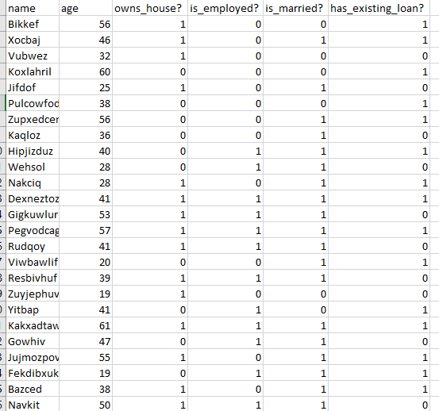
Entropy Example
Code: C:\code\
Data Analytics\
Decision_Tree_Create_Dummy_Data.py
Dataset: decision_tree_data.csv

Slide 47
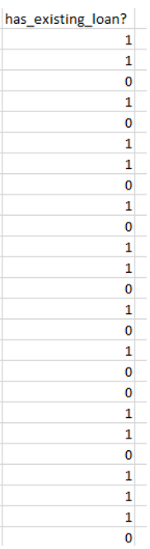
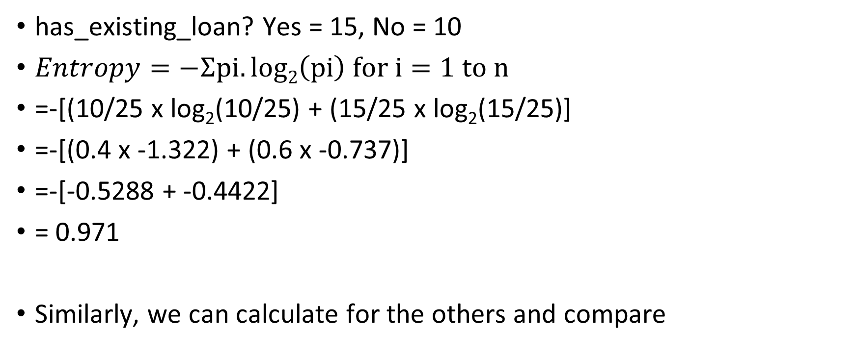
Entropy of has_existing_loan? Column
has_existing_loan? Yes = 15, No = 10
$Entropy=−Ʃpi.log2\left(pi\right) for i=1 to n$
=-[(10/25 x log₂(10/25) + (15/25 x log₂(15/25)]
=-[(0.4 x -1.322) + (0.6 x -0.737)]
=-[-0.5288 + -0.4422]
= 0.971
Similarly, we can calculate for the others and compare

Slide 48
Entropy and Decision Trees
Suppose we are building a decision tree to predict whether a loan given to a person would result in a write-off or not
Features (Independent variables): Balance (<50k or >50k) and Residence (Own, Rented, Other)
Target variable: Write-off or No write-off
Current dataset has 30 records: 16 write-offs, 14 non-write-offs

Slide 49
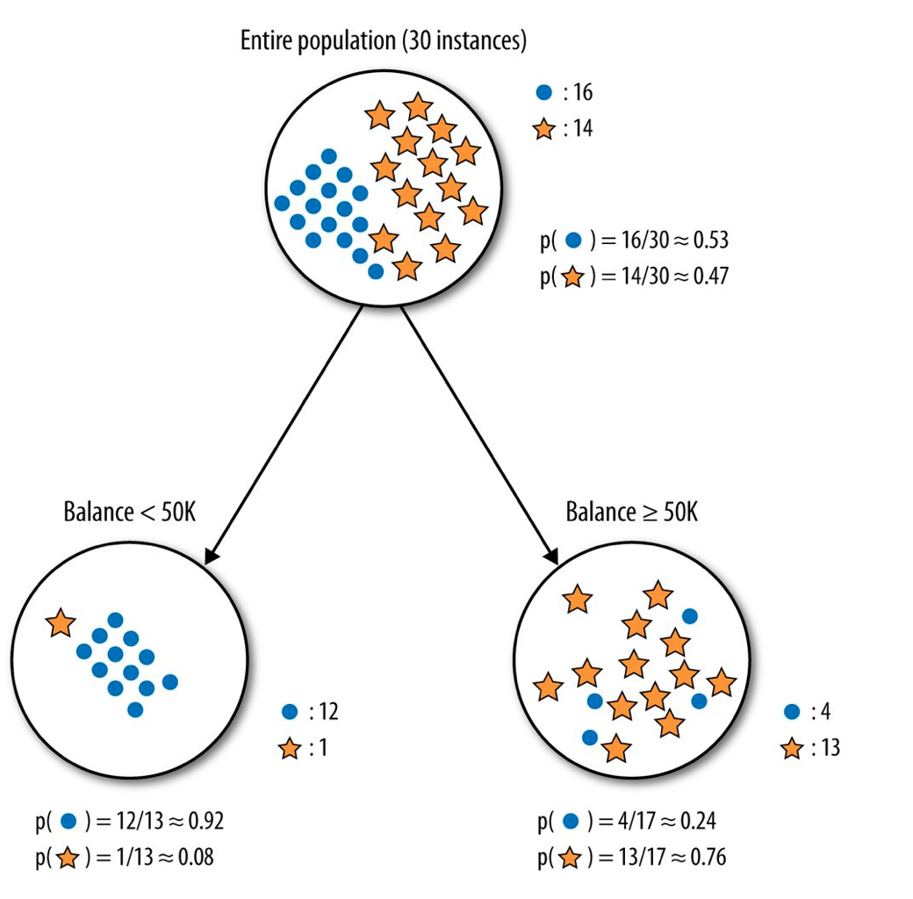
Decision Tree using Balance as the Split
Dots: Write-off, Stars: Non-write-offs
We first split the tree on Balance
Left node: 13 records
Write offs = 12 (Probability = 12/13 = 0.92)
Non-write-offs: 1 (Probability = 1/13 = 0.08)
Right node: 17 records
Write-offs: 4 (Probability = 4/17 = 0.24)
Non-write-offs: 13 (Probability = 13/17 = 0.76)

Slide 50
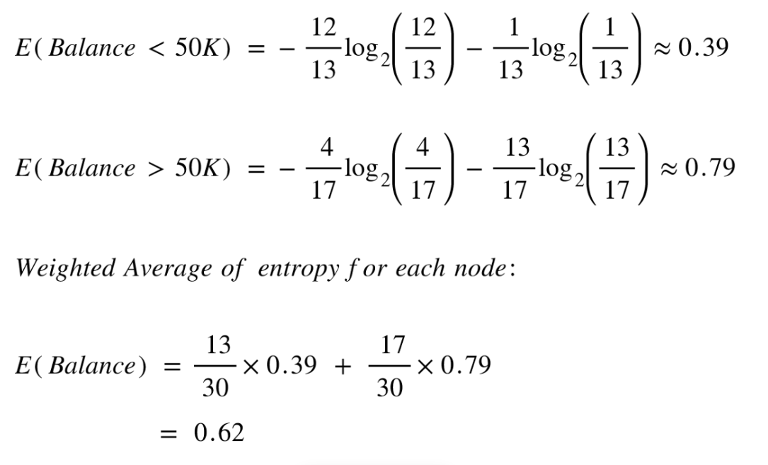
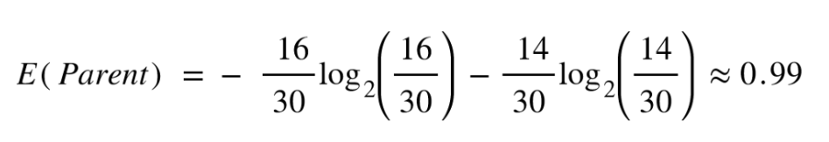
Entropy for the Parent and then After Splitting on the Balance Column

Slide 51
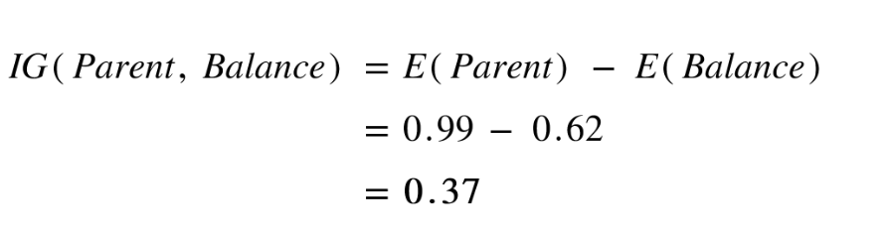
Information Gain
Information gain is the difference in entropy before and after a split in a decision tree
Conclusion: Splitting on feature ,“Balance” leads to an information gain of 0.37 on our target variable. Let us do the same thing for feature, “Residence” to see how it compares.

Slide 52
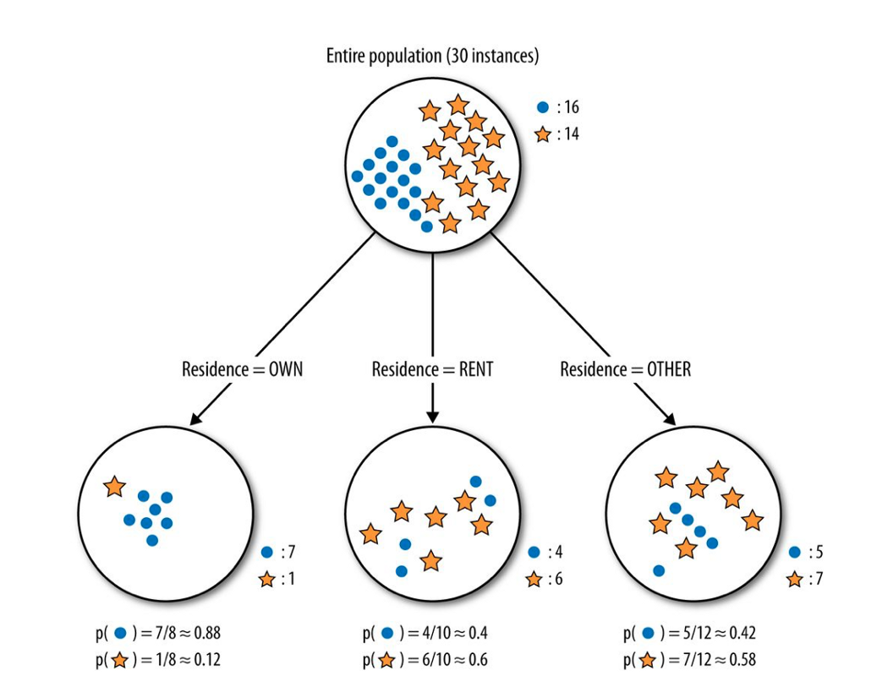
What if we split the Tree on Residence?
Splitting the tree on Residence gives us 3 child nodes.
Left child node: 8 nodes
Write-off: 7/8 (Probability 0.88)
Non-write-off: 1/8 (Probability 0.12)
Middle child nodes: 10 nodes
Write-off: 4/10 (Probability 0.40)
Non-write-off: 6/8 (Probability 0.60)
Right child node: 12 nodes
Write-off: 5/12 (Probability 0.42)
Non-write-off: 7/12 (Probability 0.58)

Slide 53
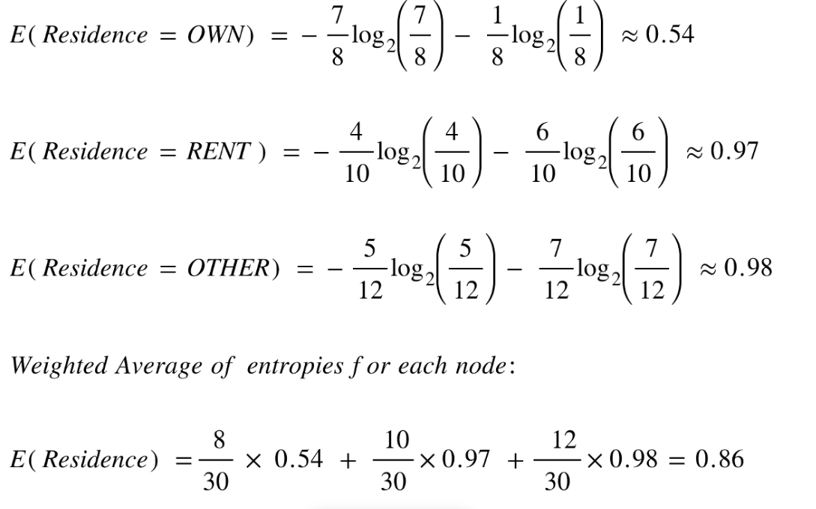
Entropy After Splitting on the Residence Column

Slide 54
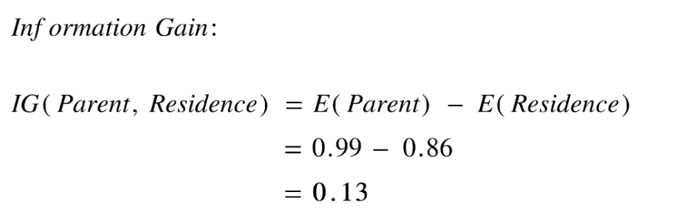
Information Gain if Split is on the Residence Column

Slide 55
Conclusion
Information Gain if split on Balance = 0.37
Information Gain if split on Residence = 0.13
Balance predicts our target variable better than residence
First split of the tree should happen on Balance

Slide 56
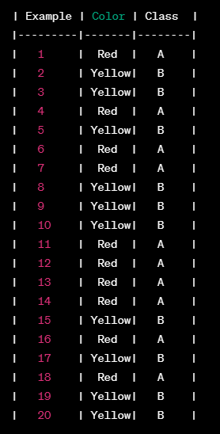
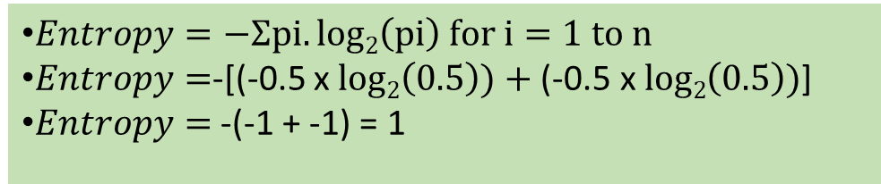
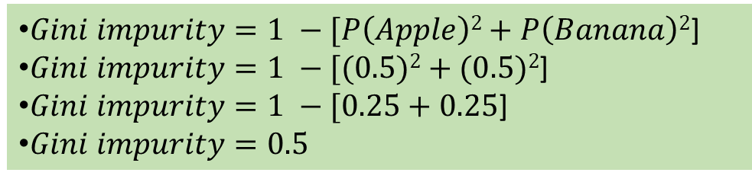
Gini Index/Coefficient/Impurity
P(Apple) = 10/20 = 0.5
P(Banana) = 10/20 = 0.5
Gini impurity is sometimes used instead of entropy (Lower the better, 0 is the best)
Example: Predict fruit (A=Apple, B=Banana)
$Entropy=−Ʃpi.log2\left(pi\right) for i=1 to n$
$Entropy=$-[(-0.5 x $log2\left(0.5\right))+\text{(}\text{−}\text{0.5 }\text{x} log2\left(0.5\right))$]
$Entropy=$ -(-1 + -1) = 1
$Gini impurity=1 −[P\left(Apple\right)2+P\left(Banana\right)2$]
$Gini impurity=1 −[(0.5)2+(0.5)2$]
$Gini impurity=1 −[0.25+0.25$]
$Gini impurity=0.5$

Slide 57
When We Have More Classes
Consider we have three classes with probabilities of 0.4, 0.4, and 0.2 respectively
Gini impurity = 1 - (p1^2 + p2^2 + p3^2)
Gini impurity = 1 - (0.4^2 + 0.4^2 + 0.2^2)
Gini impurity = 1 - (0.16 + 0.16 + 0.04)
Gini impurity = 1 - 0.36
Gini impurity = 0.64
Conclusion: More classes, higher Gini impurity

